Slide 1

Reactive Programming
with Reactive Extensions

Slide 2


Thanks

Slide 3



About Jaume Vinyes
Sotware engineer at NDT Global
@jvinyes
JimmyBcn

Slide 4

What is Reactive Programming?
To react
Respond or behave in a particular way in response to a stimulus: “Pupils are reactive to light”.

Slide 5



What is Reactive Programming?
DEMO

Slide 6
What is Reactive Programming?
Stimulus
(fire & forget)
Invoice is reactive to cart
Stock is reactive to cart

Slide 7

What is Reactive Programming?
Reactive Programming
Stream of events

Slide 8
What is Reactive Programming?
Reactive Programming stands for a programming style based on the response to incoming data-flows (stimulus) and the propagation of change.
“Reactive programming is programming with asynchronous data streams”. André Staltz

Slide 9

What is Functional Reactive Programming?
Pure function
No mutable state
No side effects
Easy to reason about
Stream
Stream
Observer
SIDE EFFECT
Moving effects to the edge of the system

Slide 10

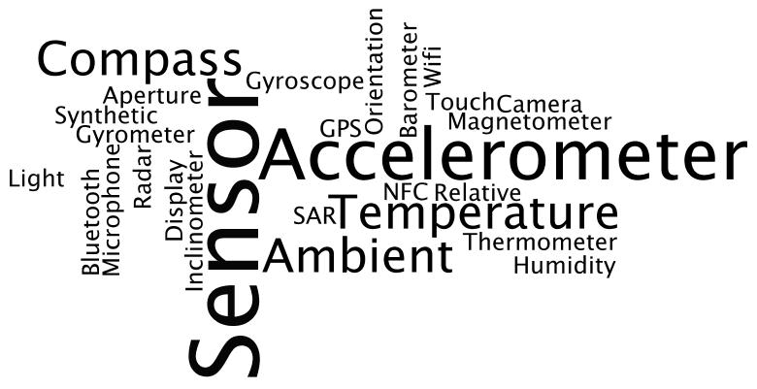
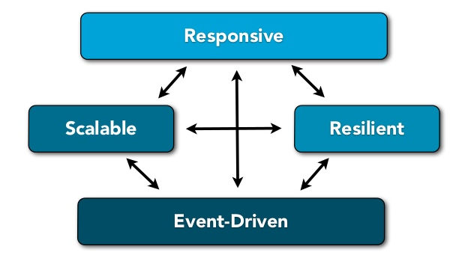


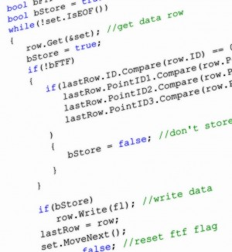

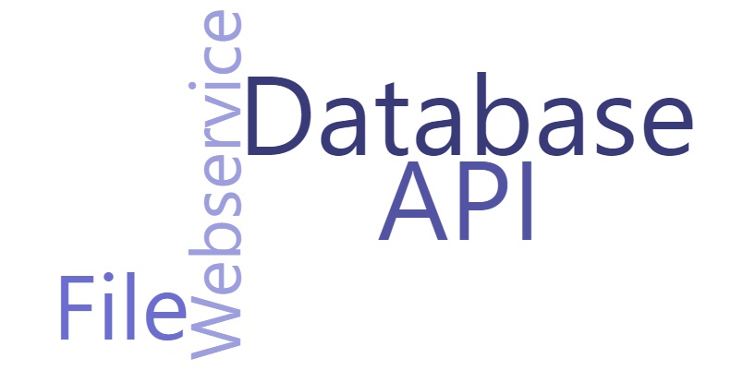
Why Reactive Programming?
Application
Event handling
Conditional statements
Attach / Detach
Modern applications are becoming ever more driven by externally produced events and streams of values
Timing / Timeouts
Scheduling
Concurrency Locking
Multithreading
Race conditions
Shared state
“We want systems that are Responsive, Resilient, Elastic and Message Driven.
We call these Reactive Systems”
Amazing toolbox of functions to combine, create and filter any of those streams.
Developers need powerful tools to manage asychronous streams of events

Slide 11
Why Reactive Extensions ?
LINQ to Objects, LINQ to SQL & LINQ to XML → Query data in rest
Rx → Queries data in motion (streams of data)
Rx combines patterns commonly used in event-driven applications with constructs from functional programming that eliminate shared mutable state
Rx abstracts away concerns about low-level threading, thread synchronization, thread-safety, concurrency and non-blocking I/0
Use Rx for orchestrating asynchronous and event-based computations
The IObserver<T> and IObservable<T>form the fundamental building blocks for Rx. When you use Rx, you do not have the need to actually implement these interfaces, Rx provides all of the implementations you need out of the box

Slide 12
Rx Demo
Observers and Observables
Lifetime management
Subscribe and Unsubscribe
OnError, OnComplete
Hot and Cold observables
Cancellable sequences
Observables from events
Observable Factory
Functional operators
Sequence combinators
Schedulers

Slide 13
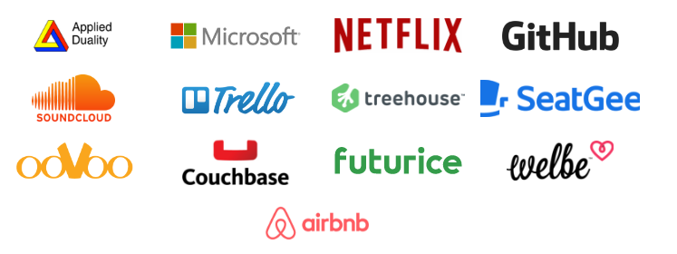
You can find Rx at

Slide 14
Resources – Reactive Programming
http://www.reactivemanifesto.org/
https://gist.github.com/staltz/868e7e9bc2a7b8c1f754
http://rxmarbles.com/
https://channel9.msdn.com/Blogs/codefest/DC2010T0100-Keynote-Rx-curing-your-asynchronous-programming-blues
https://www.youtube.com/playlist?list=PLsKpj4Bp6bFthecgXadR_l-Yg1-Vz5Q3r

Slide 15
Resources – Reactive Extensions
http://reactivex.io/
http://www.introtorx.com/
http://rxwiki.wikidot.com/101samples
https://channel9.msdn.com/Series/Rx-Workshop
https://channel9.msdn.com/Blogs/J.Van.Gogh
https://channel9.msdn.com/Events/NET-Conference/2016/Rx-la-joya-oculta-de-NET
https://blogs.msdn.microsoft.com/rxteam/2010/07/15/rx-hands-on-labs-published/
https://msdn.microsoft.com/es-es/library/hh242981.aspx

Slide 16
People
Lee Campbell (Author of Introduction to Rx book)
Erik Meijer (Author of Rx)
Matthew Podwysocki (Author of Rx)
Jafar Husain (Tech lead at Netflix)
Ben Lesh (Autor of RxJs and Software Enginner at Netflix)
Sergi Mansilla (Author of Reactive programming with RxJs book)
André Staltz (Author of Cycle.Js)

Slide 17


